Slide 1

Enrollmania Masterclass:
Strageties to Elevate Your Charter School Enrollment
FCSC+SCS 2024

Slide 2
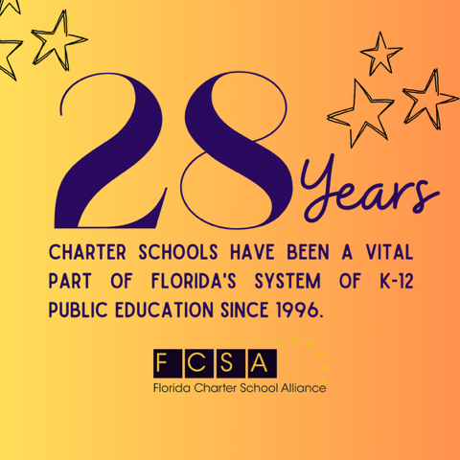
About the FCSA
A statewide non-profit, member-driven association working for charter schools & their stakeholders at the federal, state, and district levels.
FCSA advocates for, defends, supports, and collaborates with public charter schools to influence legislative policy and environments.

Slide 3
FCSC+SCS 2024
Enrollmania Masterclass:
Strageties to Elevate Your Charter School Enrollment
Presenter:
Lynn Norman-Teck, Executive Director
Lynn@FLcharteralliance.org

Slide 4
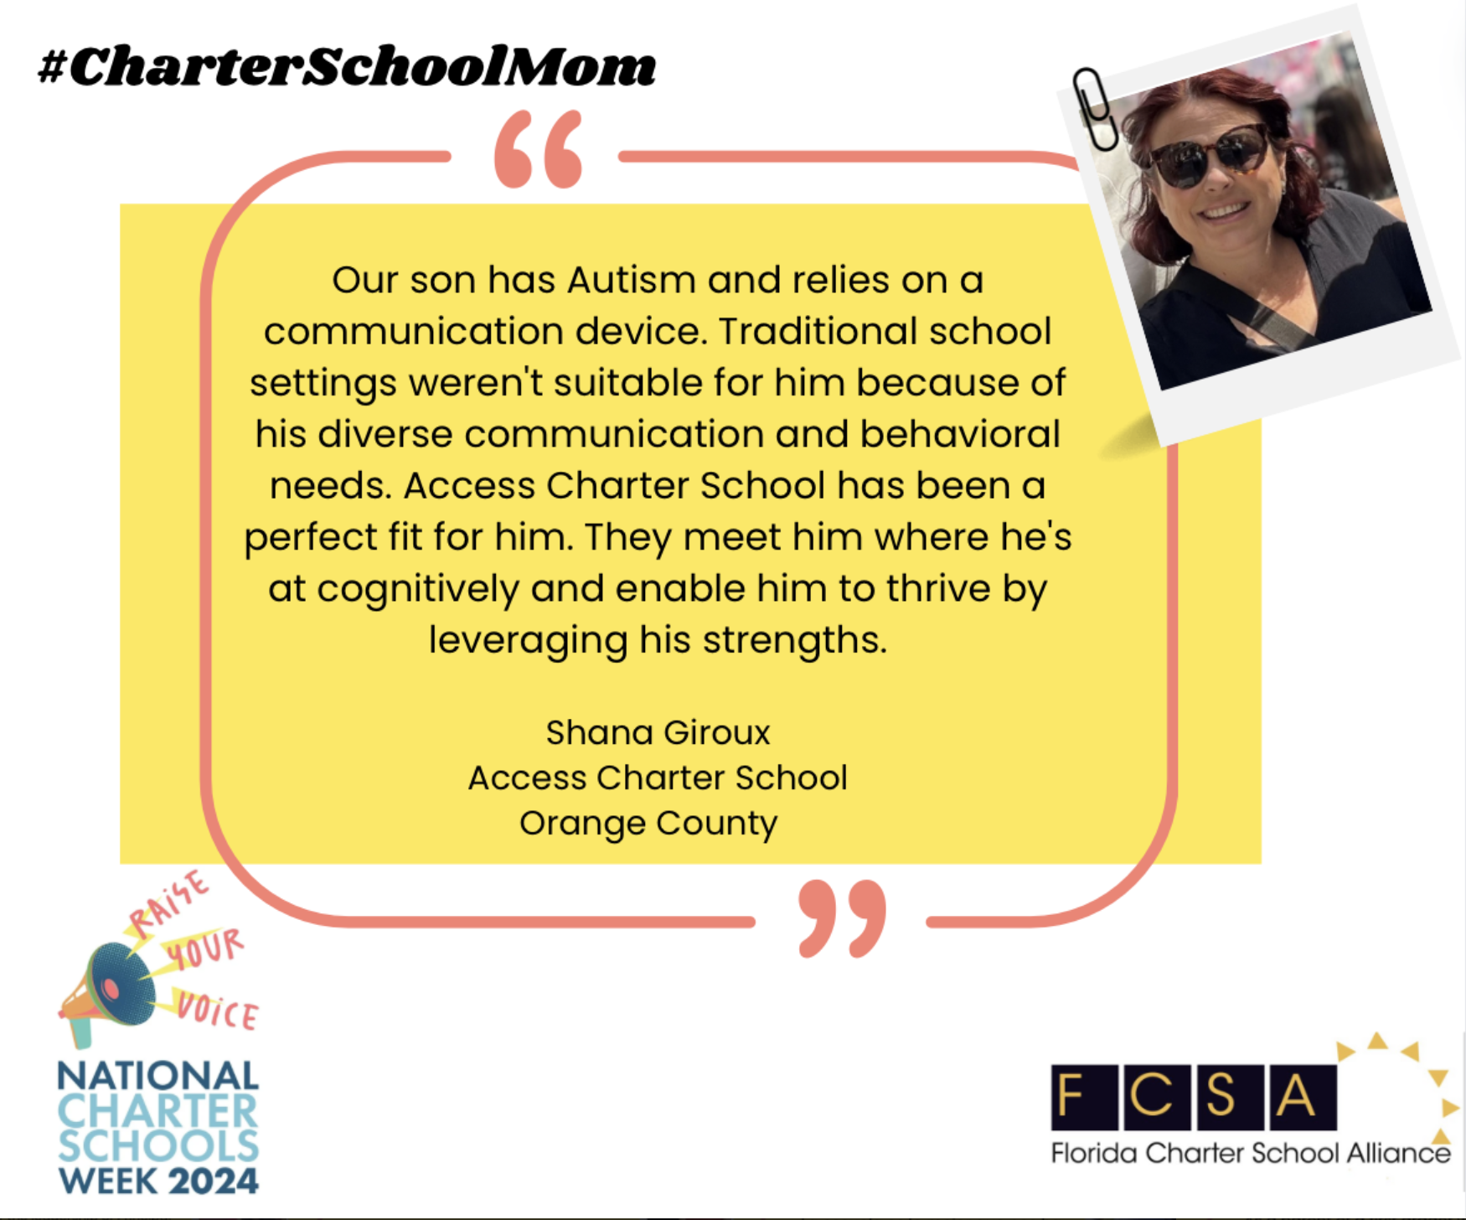
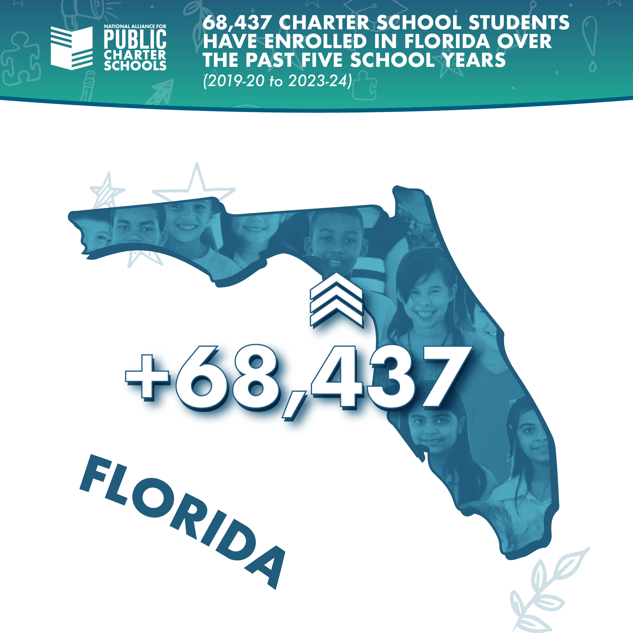
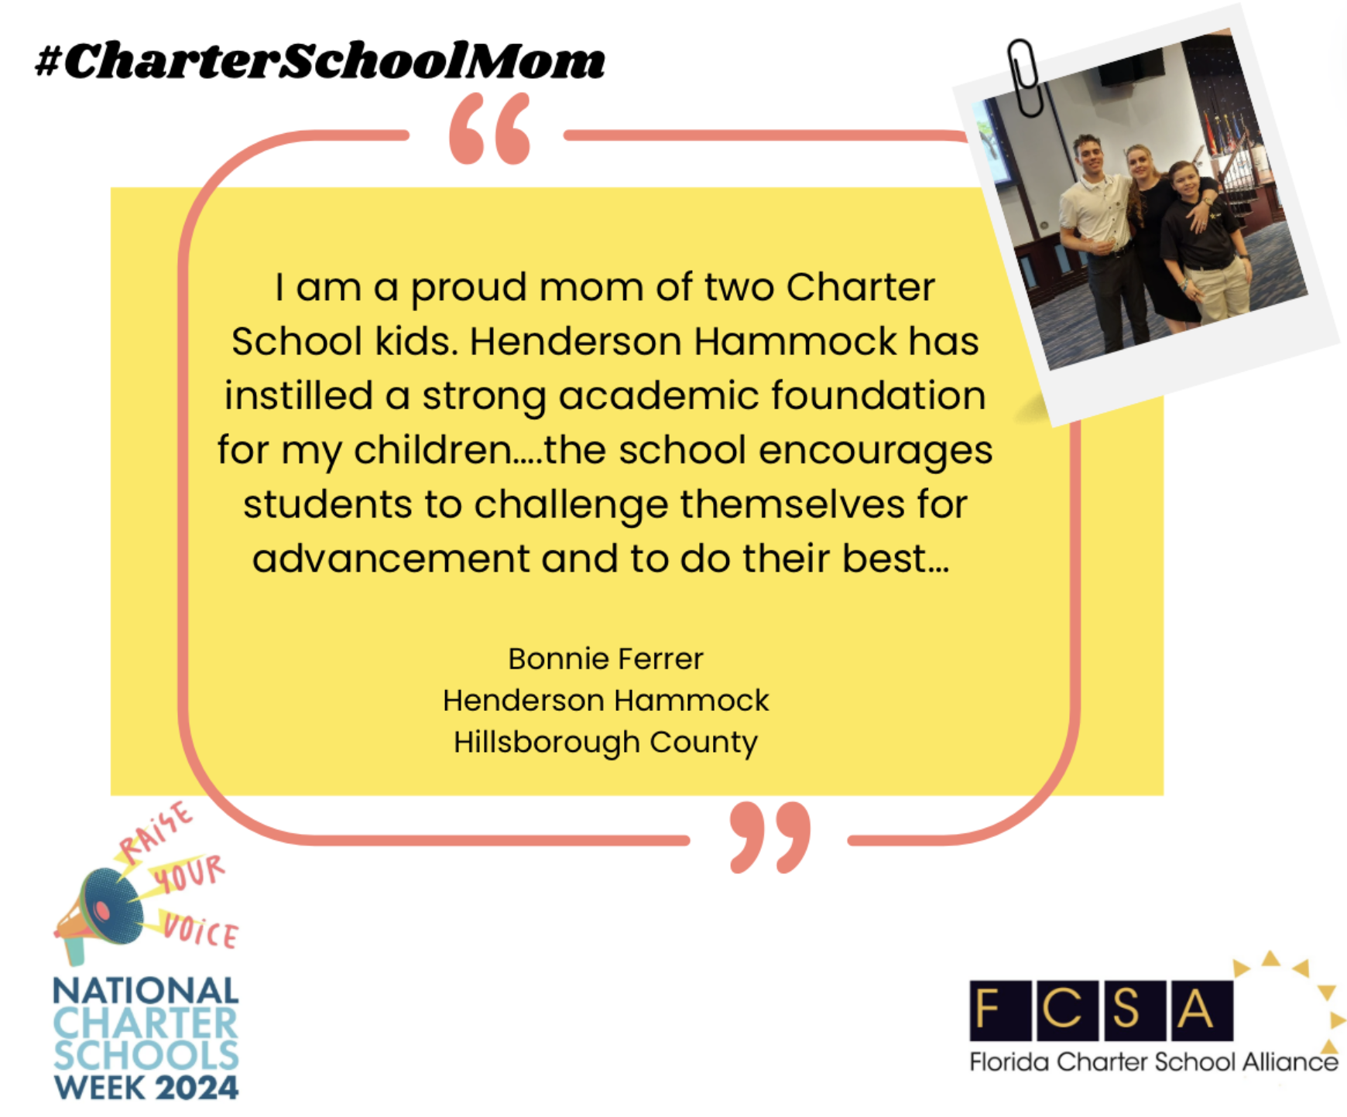
Enrollment Drives your Budget
Charter School Enrollment is rising
but it’s a competitive education landscape.
Good news: Parents know what a charter school is.
Bad news: You need to skillfully communicate who you are and set yourself apart.
School choice is no longer just about proximity but about value. Ask yourself: What unique programs or opportunities does my school offer?
https://shorturl.at/uO7VE

Slide 5









Your Logo
A visual representation of your brand:
Connect with your community
Differentiate you from competitors
Convey the school’s personality & mission
Warm colors like red, orange, and yellow (along with all their variations) generally represent feelings of energy, passion, movement,and boldness.
Cool colors like green, blue, and purple are often more subdued. They paint a picture of calm, relaxing, and trustworthiness.
Source: GrowSchools

Slide 6
Your Website
Charter schools in Florida must maintain a website that includes the following information:
School information: The school's grade and academic performance, programs, and annual budget
Governing board: The names of the governing board members and minutes of their quarterly meetings
Parent liaison: The name and contact information of the parent liaison
Management companies: The names of any management companies, service providers, or education management corporations associated with the school
Fiscal audit: The school's annual independent fiscal audit
Contact information: The contact information for the charter school representative must be posted prominently on the website and provided to parents in writing each year
Design & Function are important
Organize strategically to best communicate with parents,
stakeholders, and prospective parents & staff
Include: grades served, location & how to apply
Your mission/focus & proof you are meeting it
Accolades, Success, Testimonials, Strengths
Search Engine Optimization (SEO)
With more than 90 percent of online experiences starting with search engines, and 80 percent of users beginning their product research online, SEO provides your company the chance to connect with consumers that haven’t committed to a business or product (source: WebFX).

Slide 7
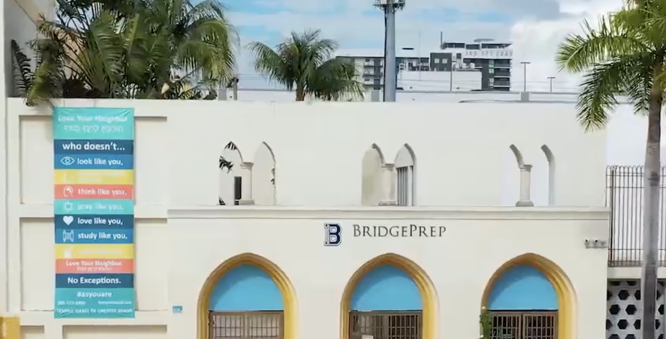

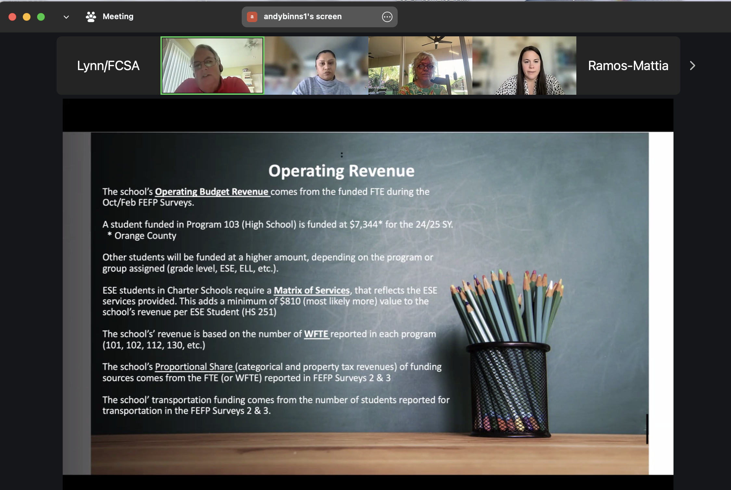
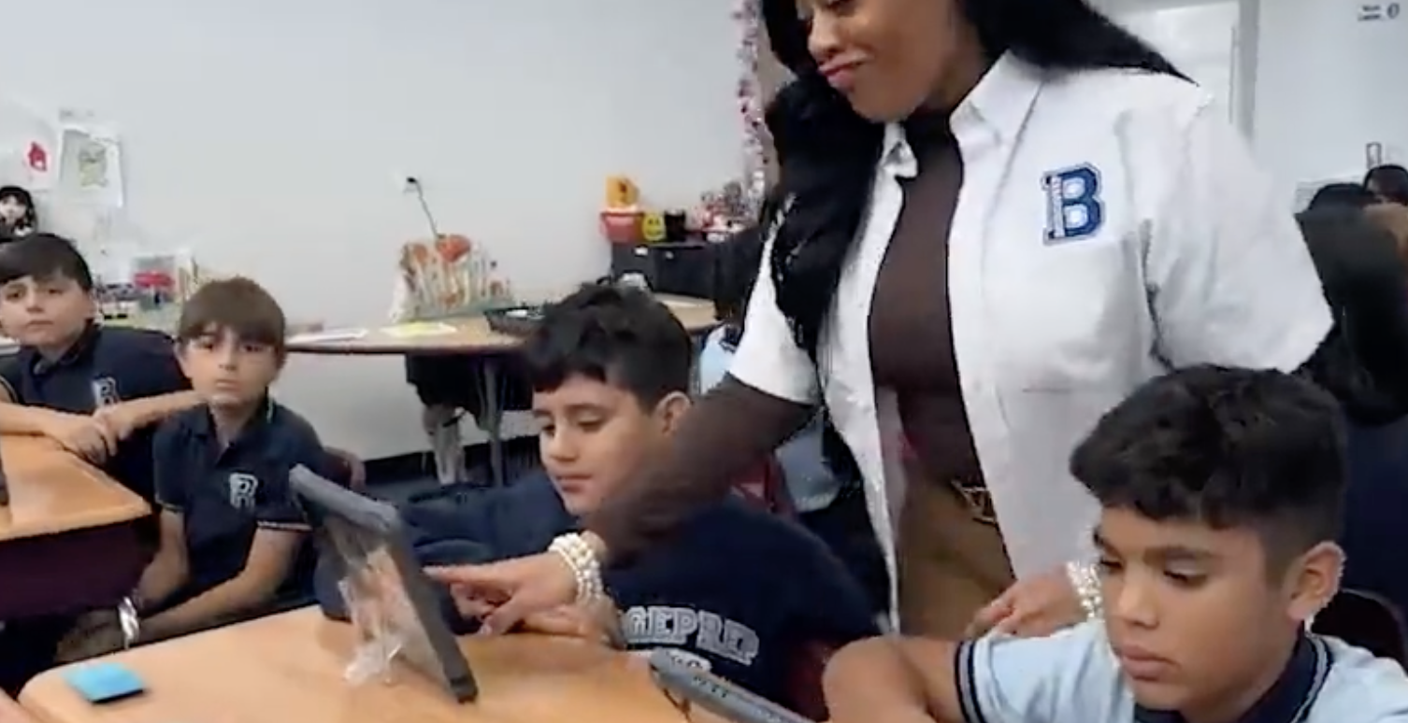
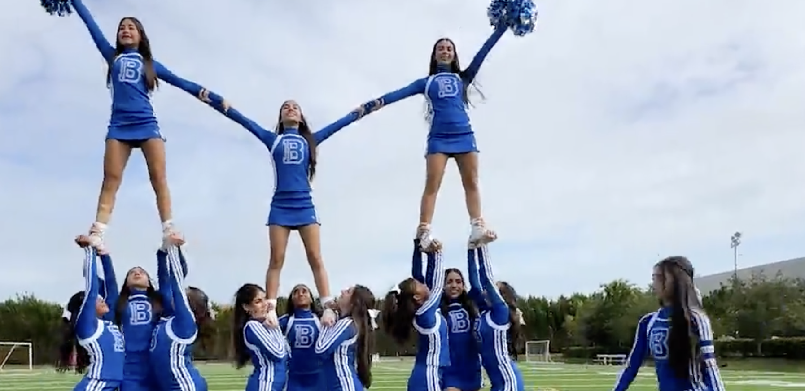
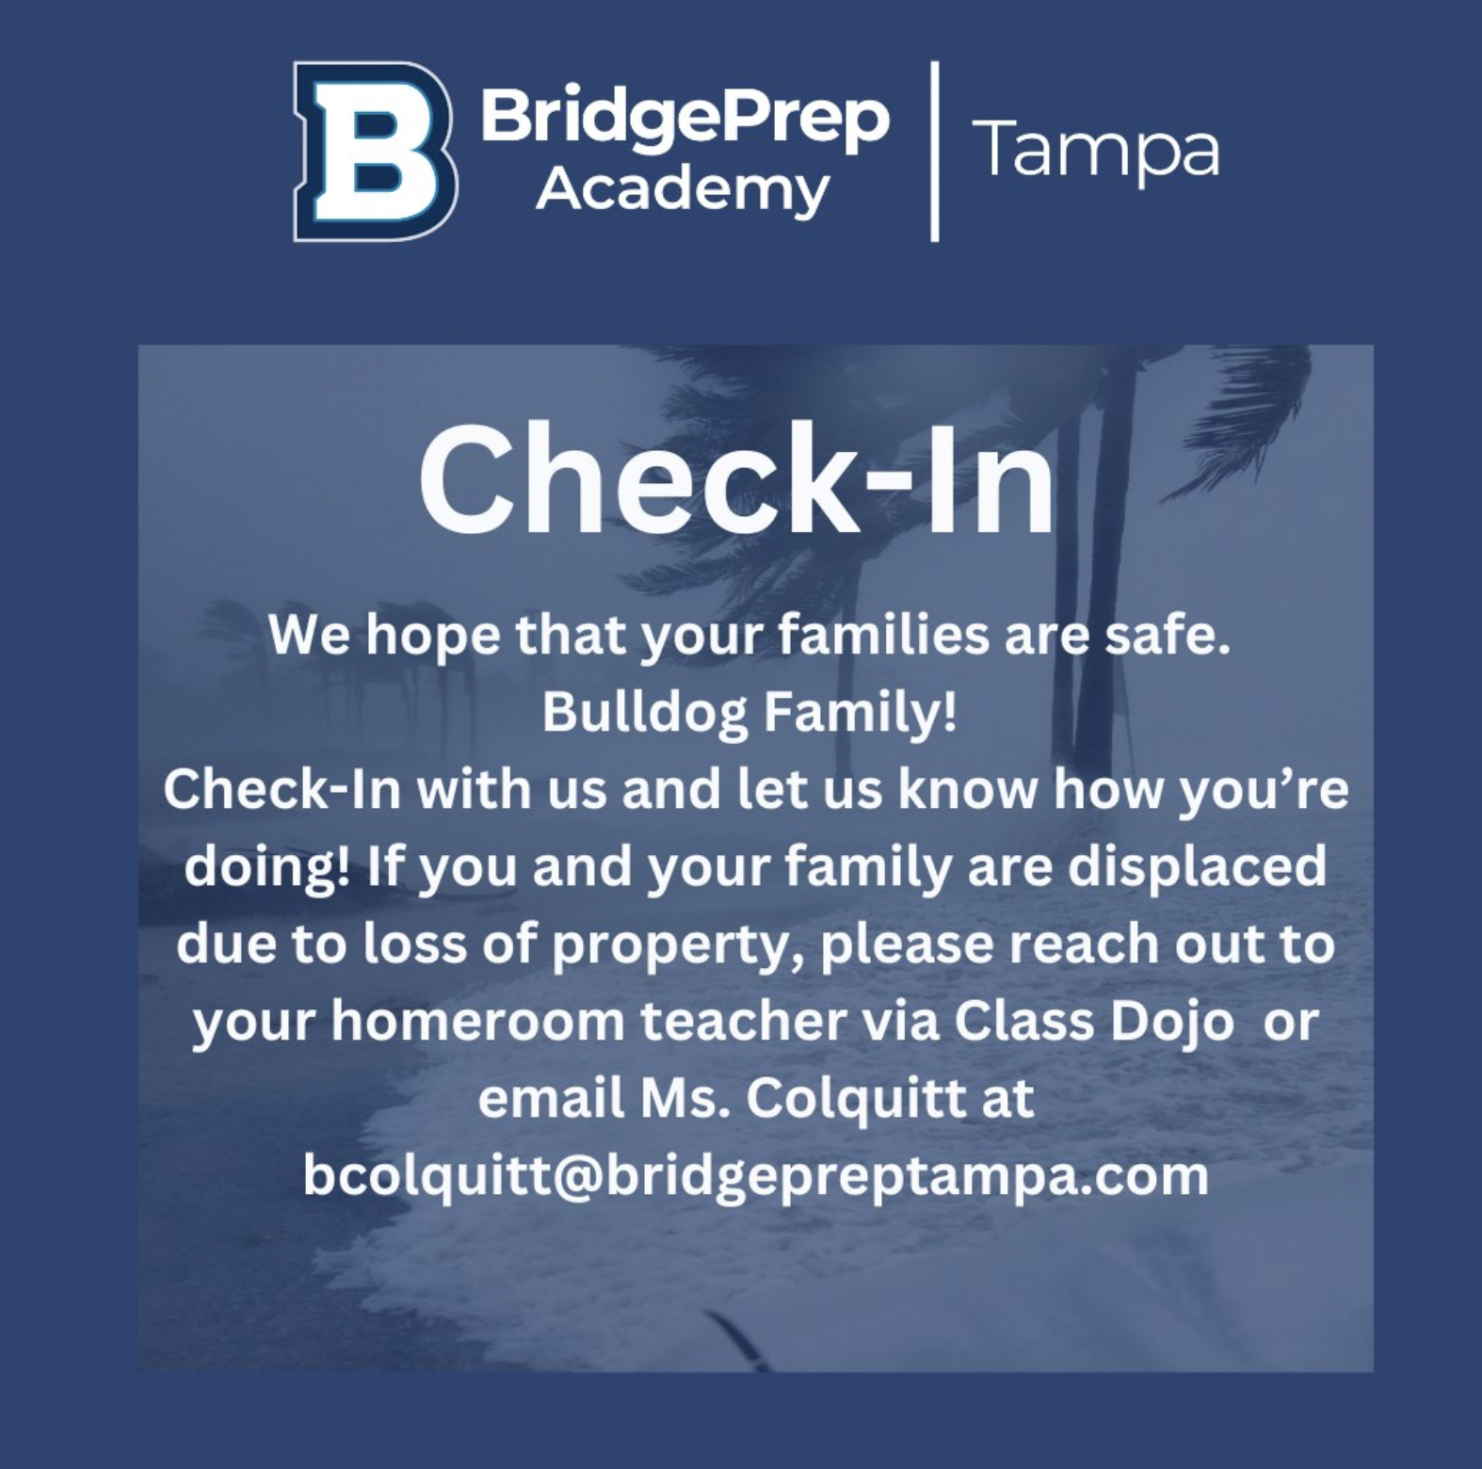
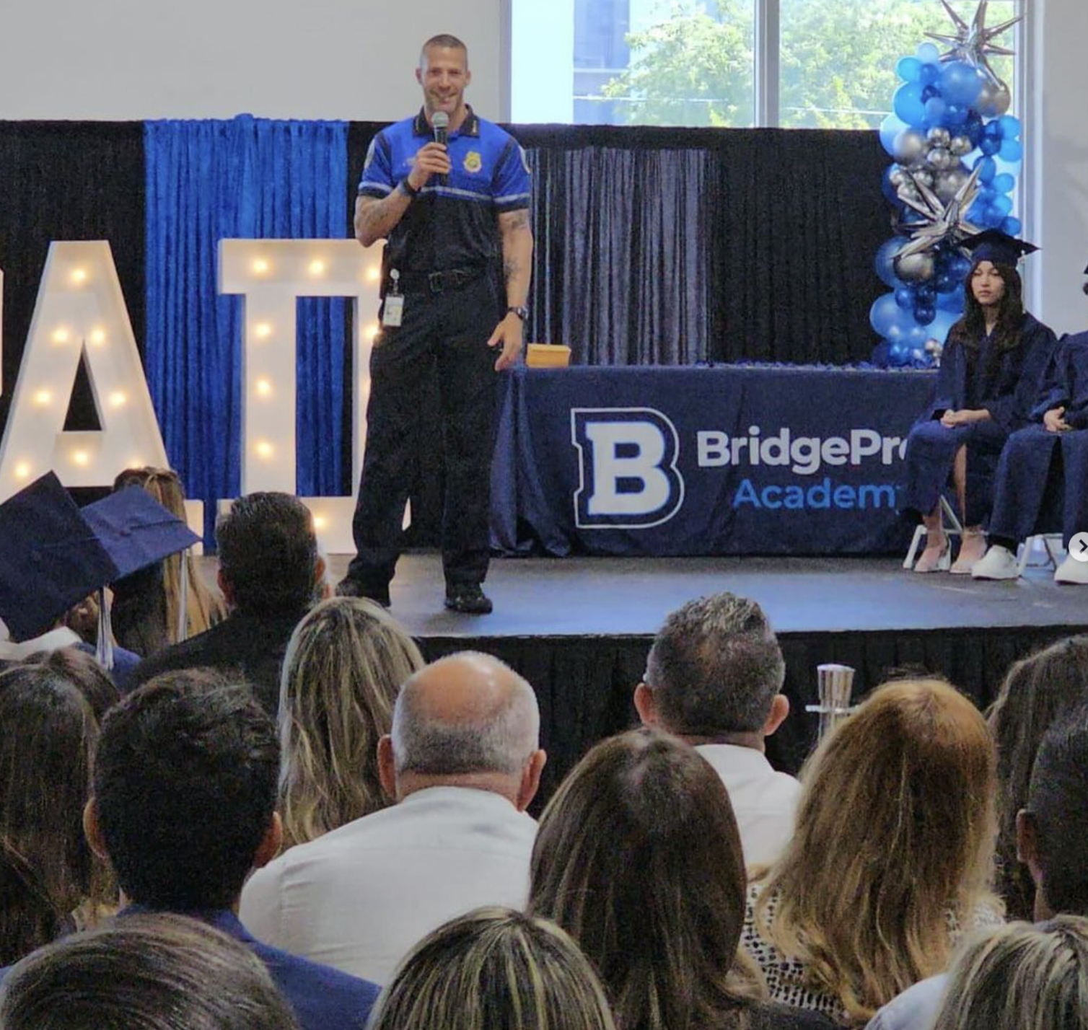
Cohesive Identity
Social Media posts
Signage
Advertising
Newsletters
Documents
Uniforms
Events

Slide 8
Marketing
Consistent and meaningful social media ads
  Clearly defined goal
  Small target audience, Geo-fencing
  High-quality, relevant, and eye-catching images or video
  Short description of the offer
  One call-to-action
  Link to your landing page
Social media posts
Signage
Events
Advertising
      Build awareness
      Encourage re-enrollment
      Share successes
      Call to Action: Inquire, Visit, Apply
Video
Compelling stories - your stakeholders are a GREAT resource
Check online reviews — a school’s first impression
Newsletter/Automated Emails
      Welcome newly enrolled families
      Nurture prospective families who recently inquired
      Onboard new faculty and staff
      Remind the community & stakeholders of upcoming events
      Promote an event
Review & Refresh your website
Public Relations

Slide 9

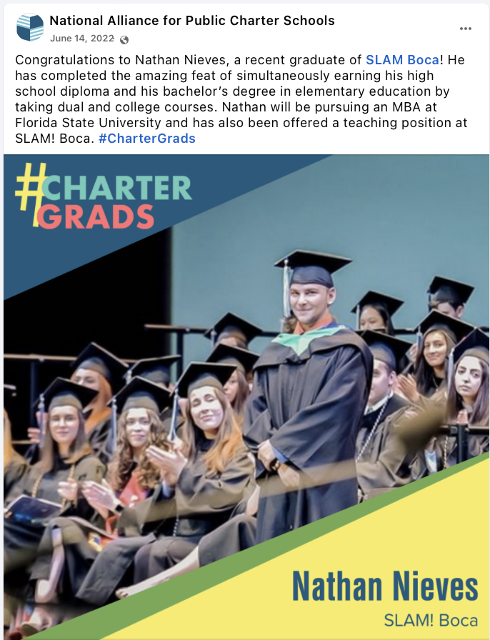

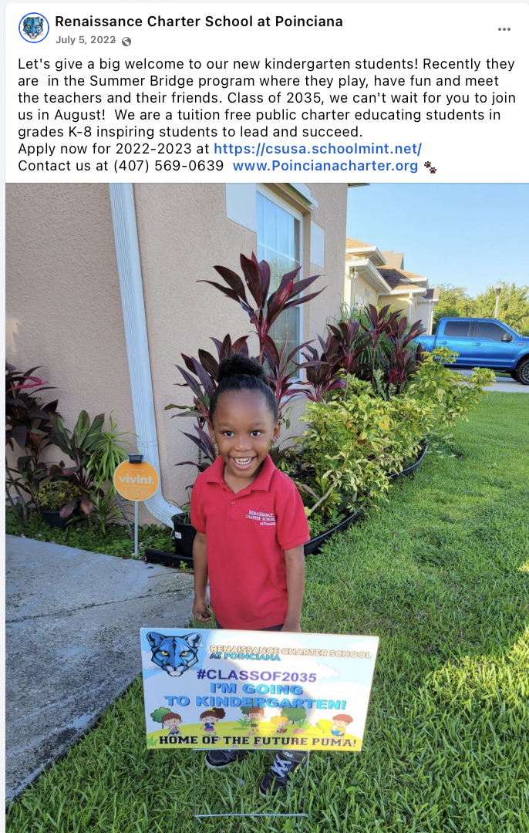
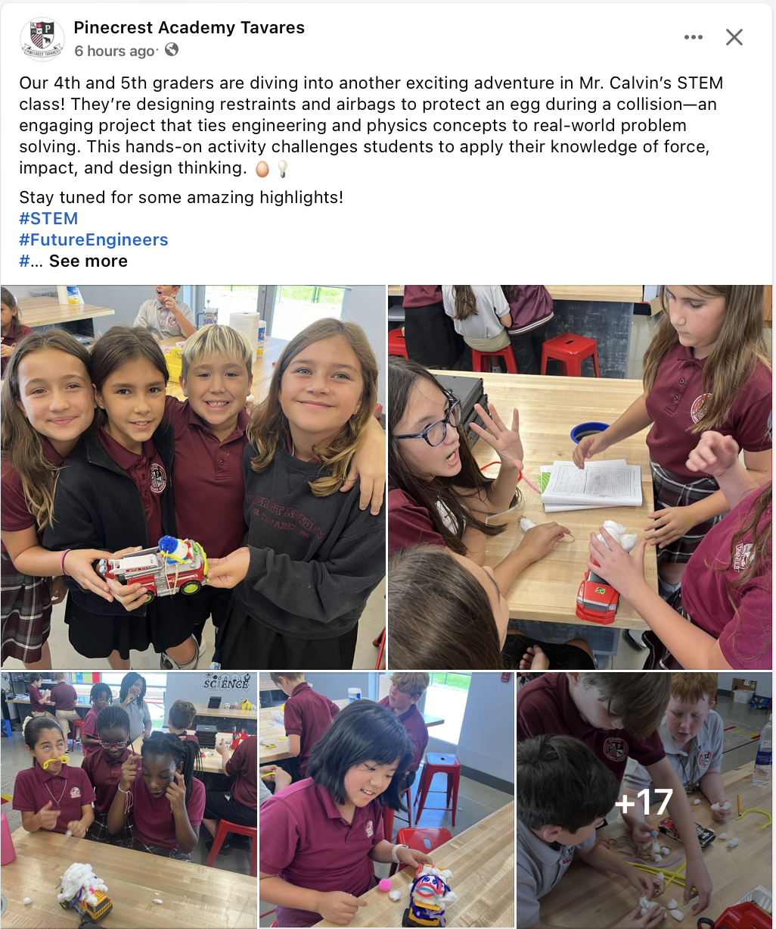

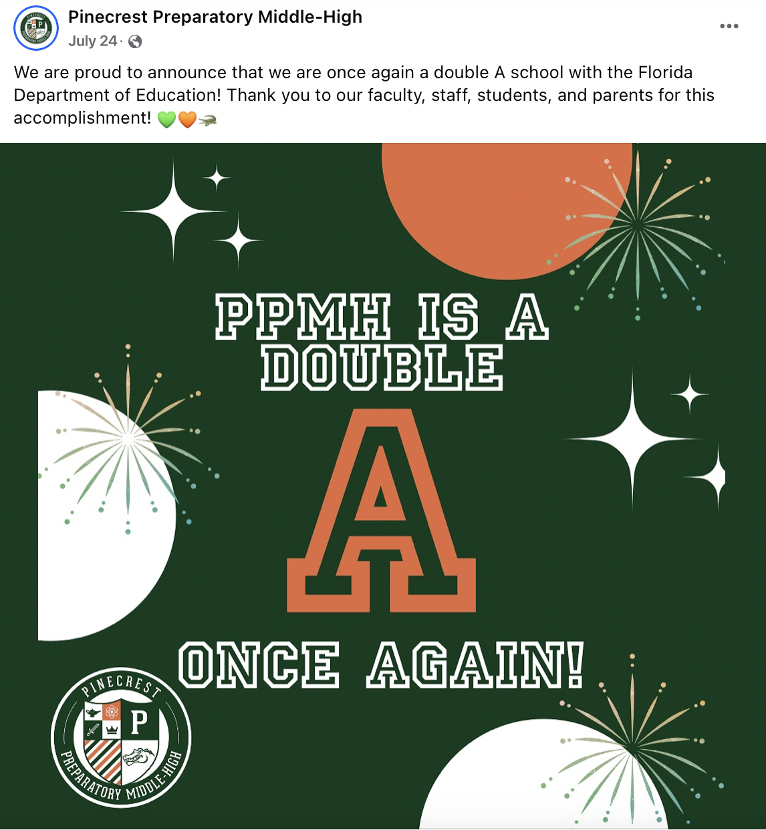
Consistent, meaningful, and
compelling social media posts, ads, messages…

Slide 10

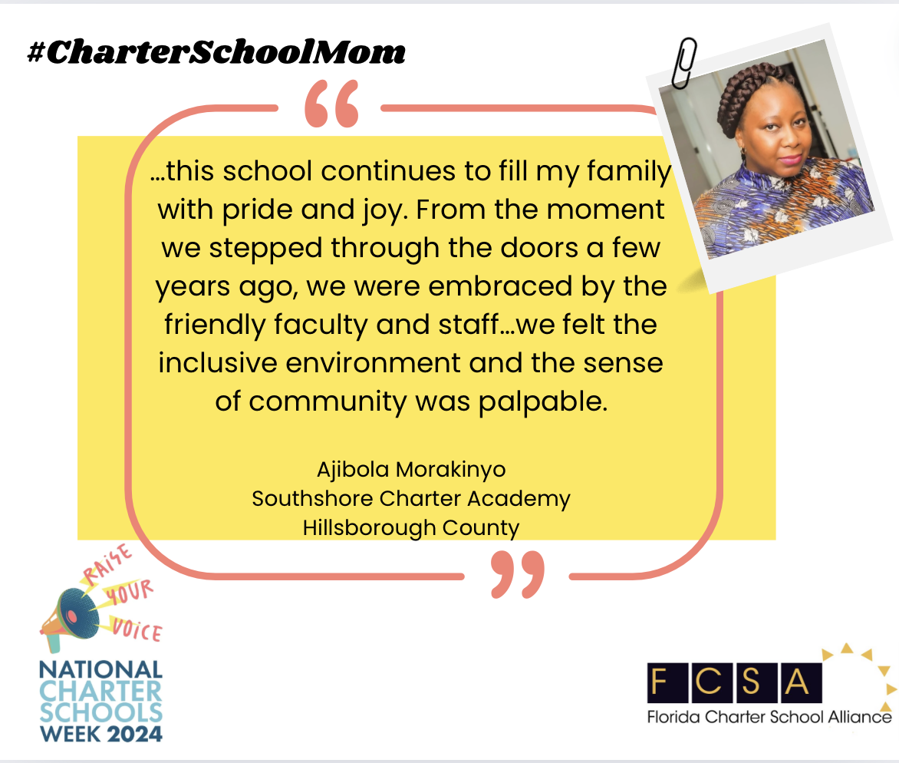



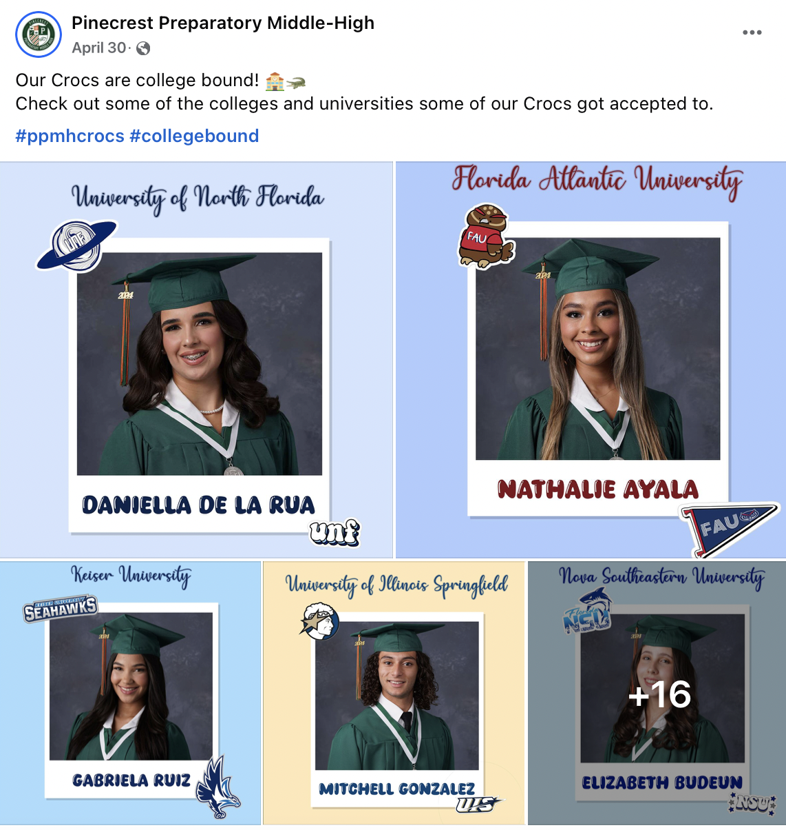


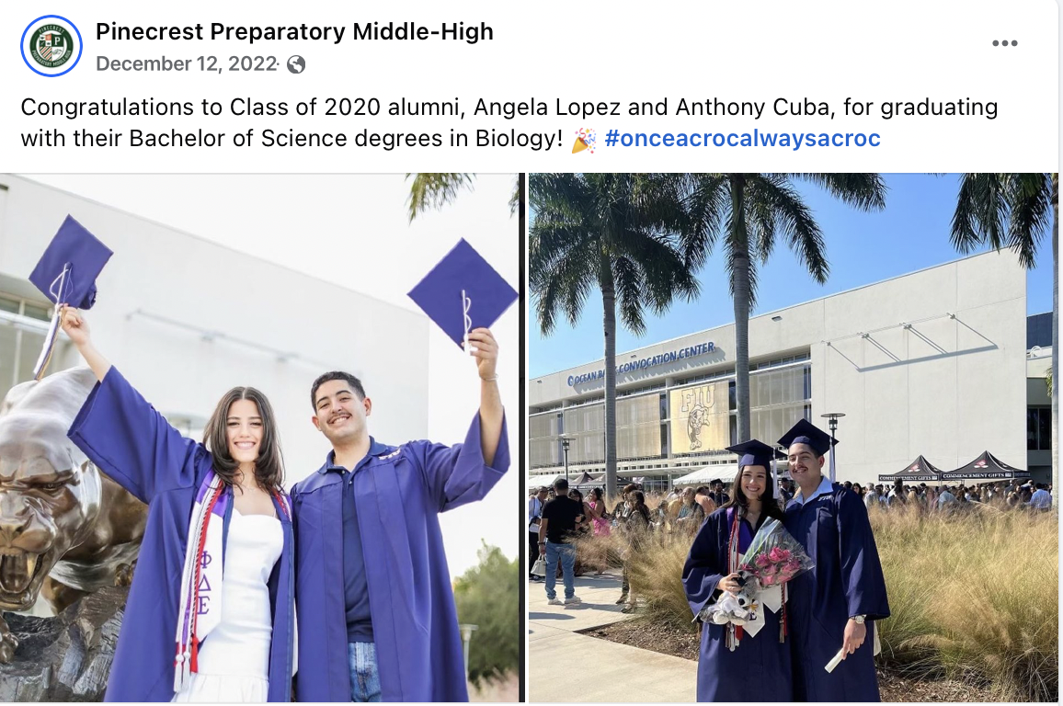
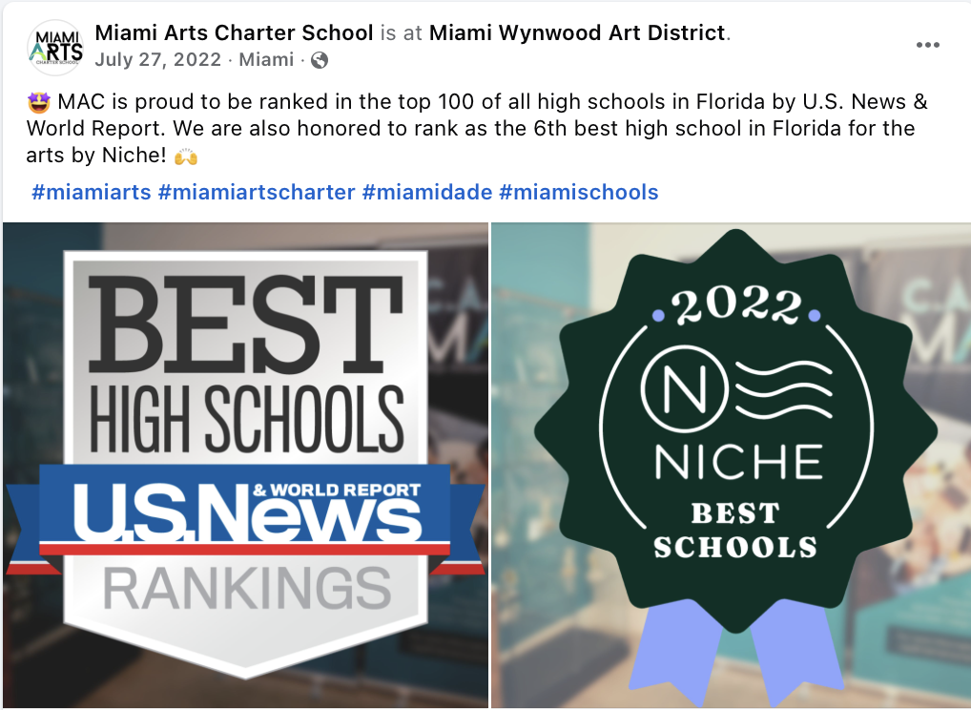
Share your successes.
Show how you’re meeting your
vision & mission
https://www.finalsite.com/blog/p/~board/b/post/what-makes-a-good-social-media-ad

Slide 11

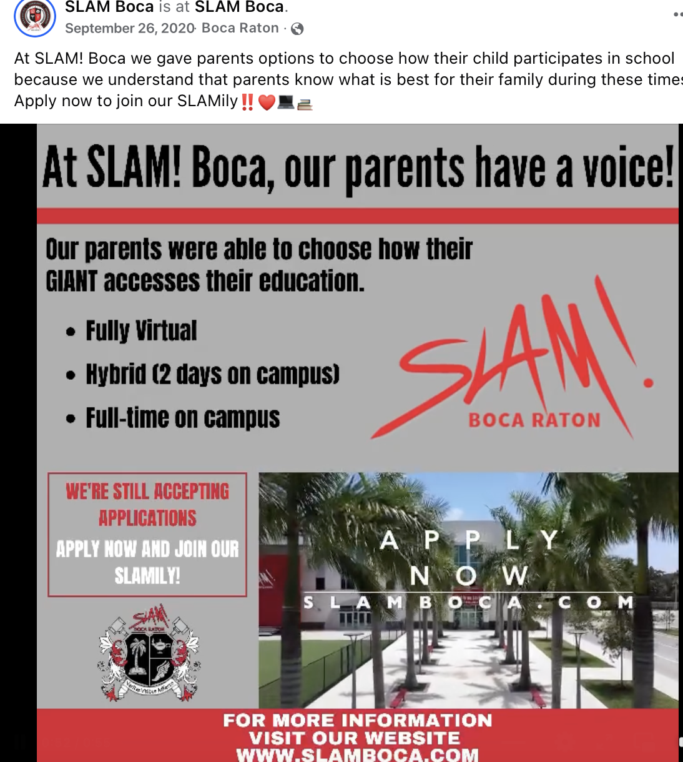

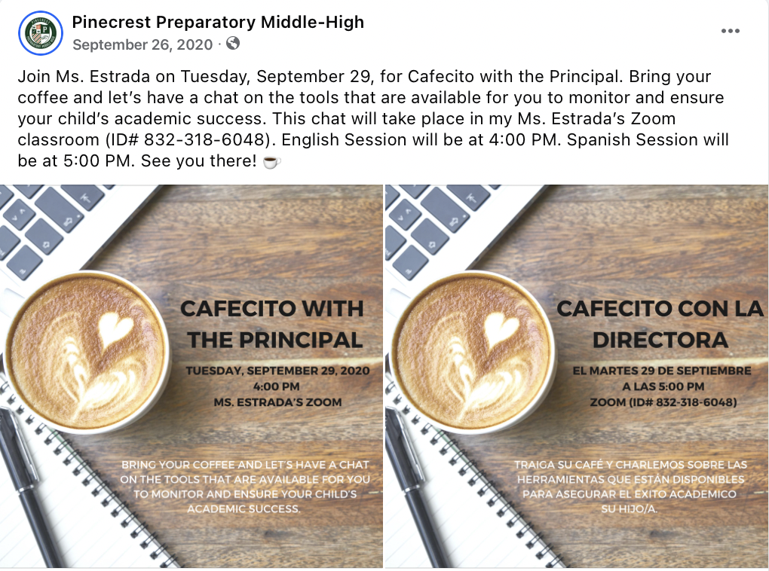

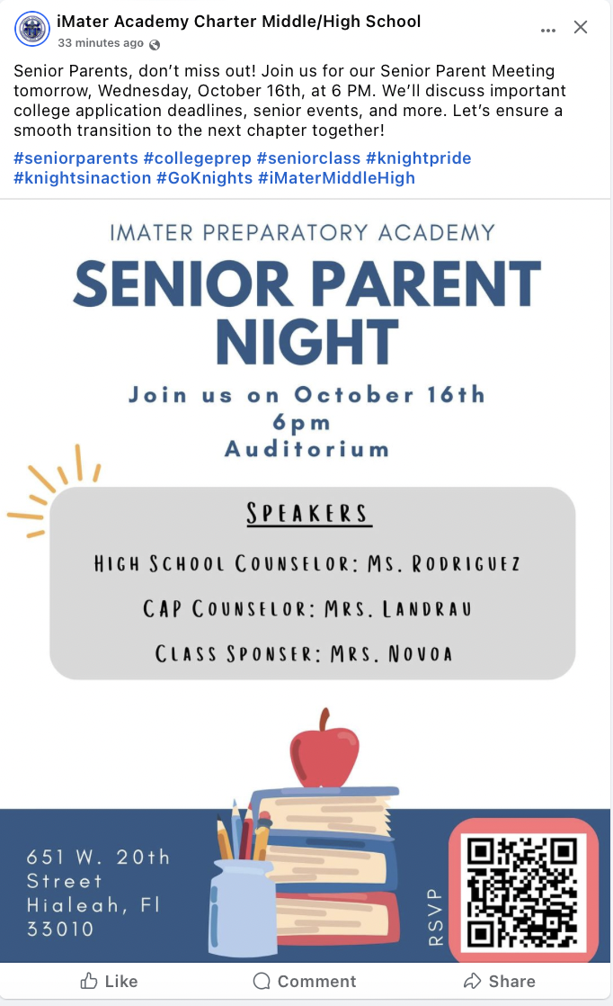
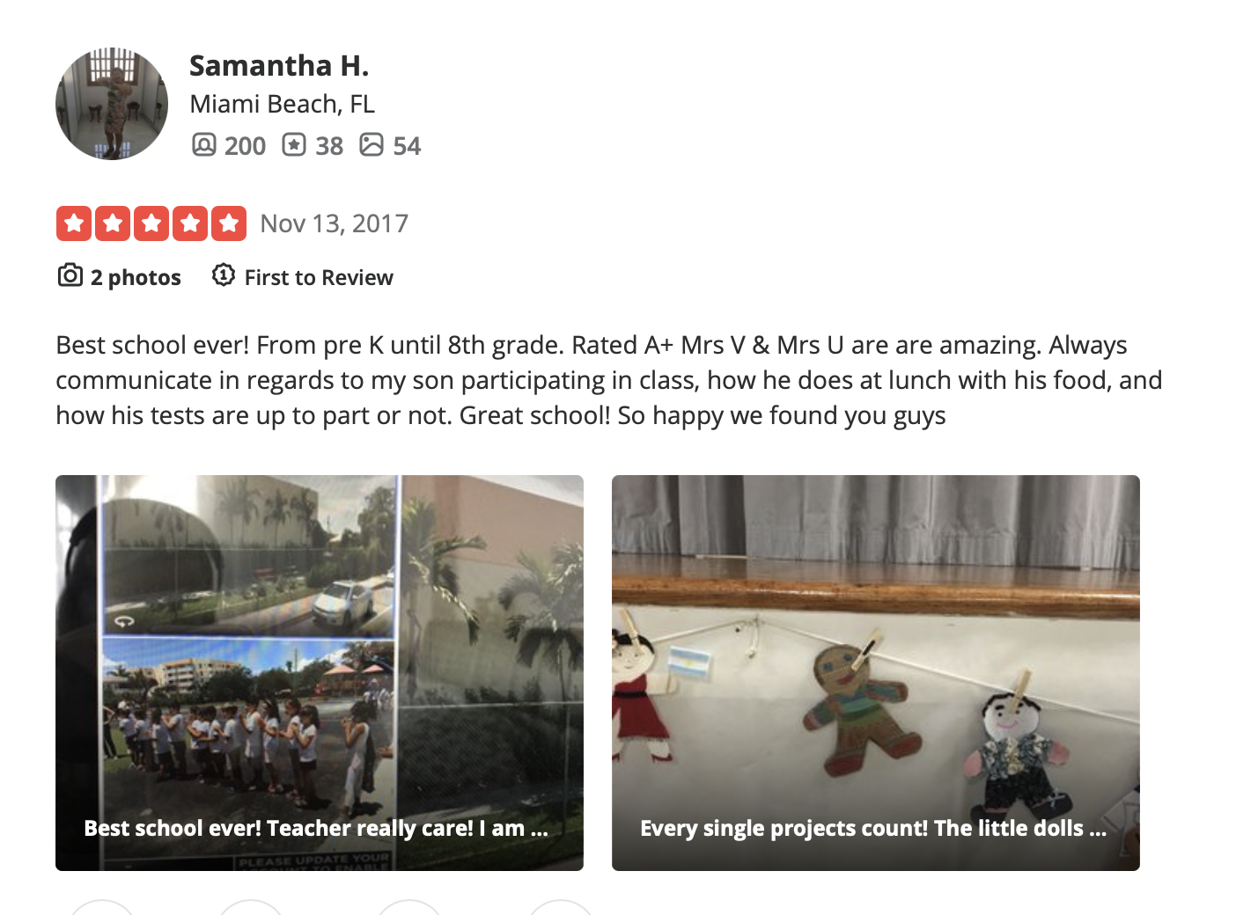


Slide 12


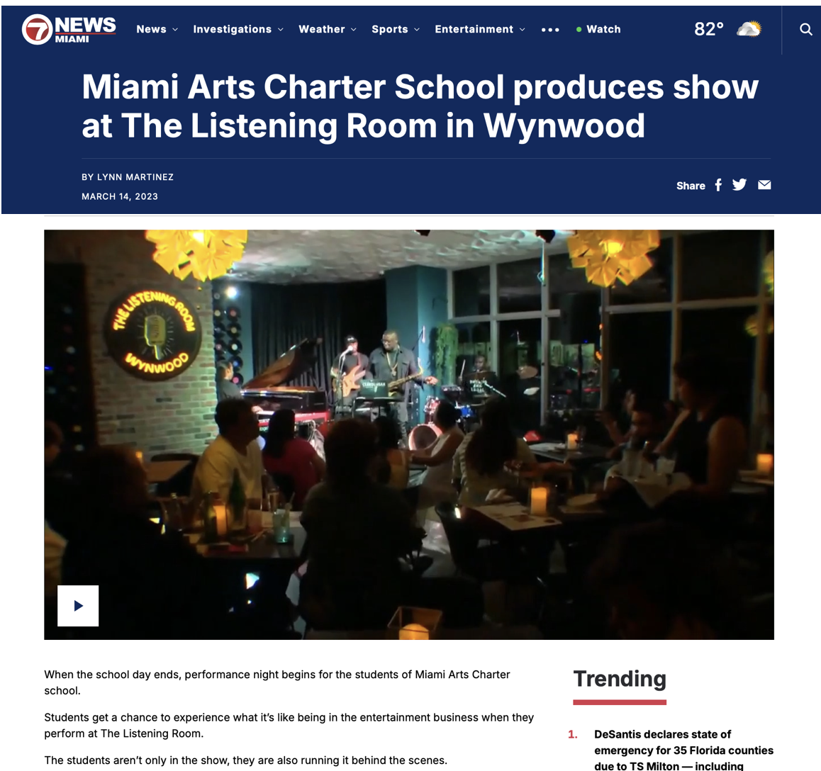
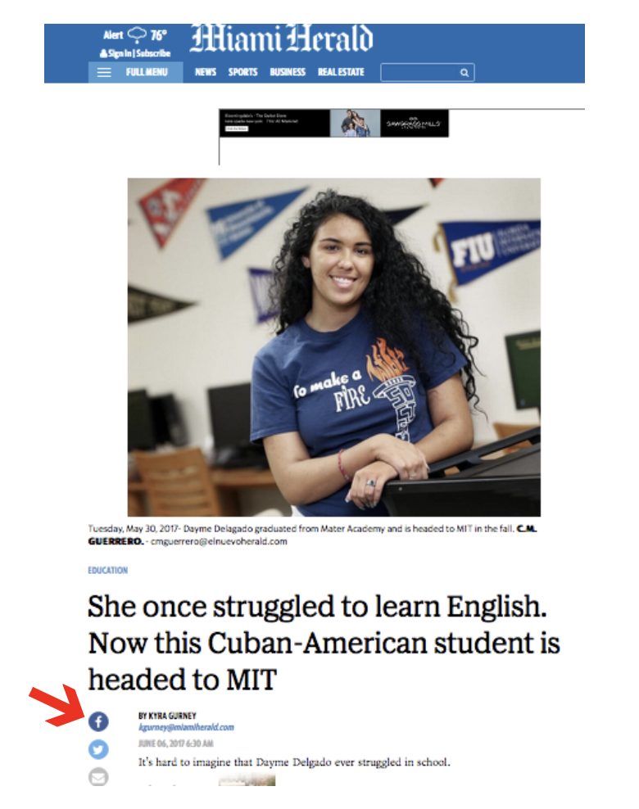

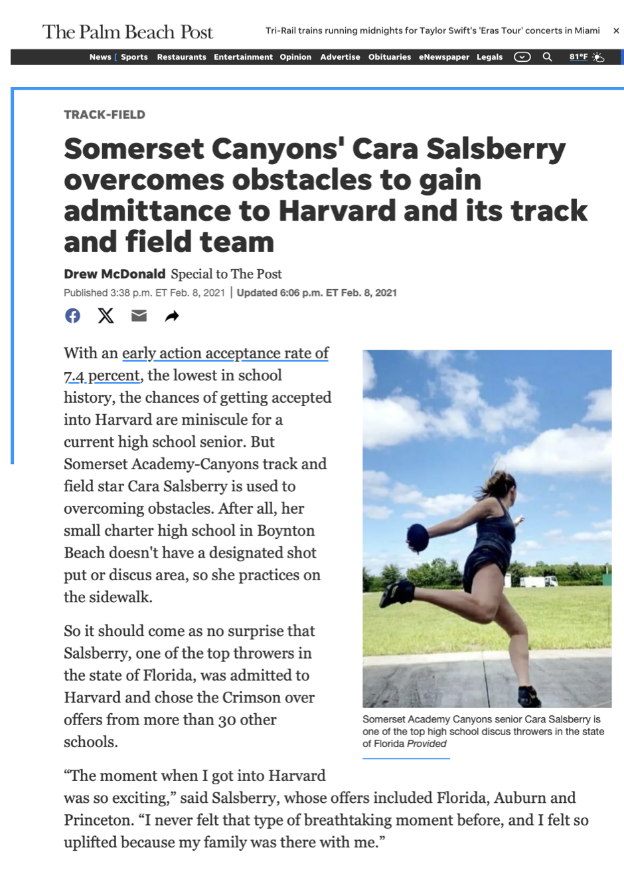

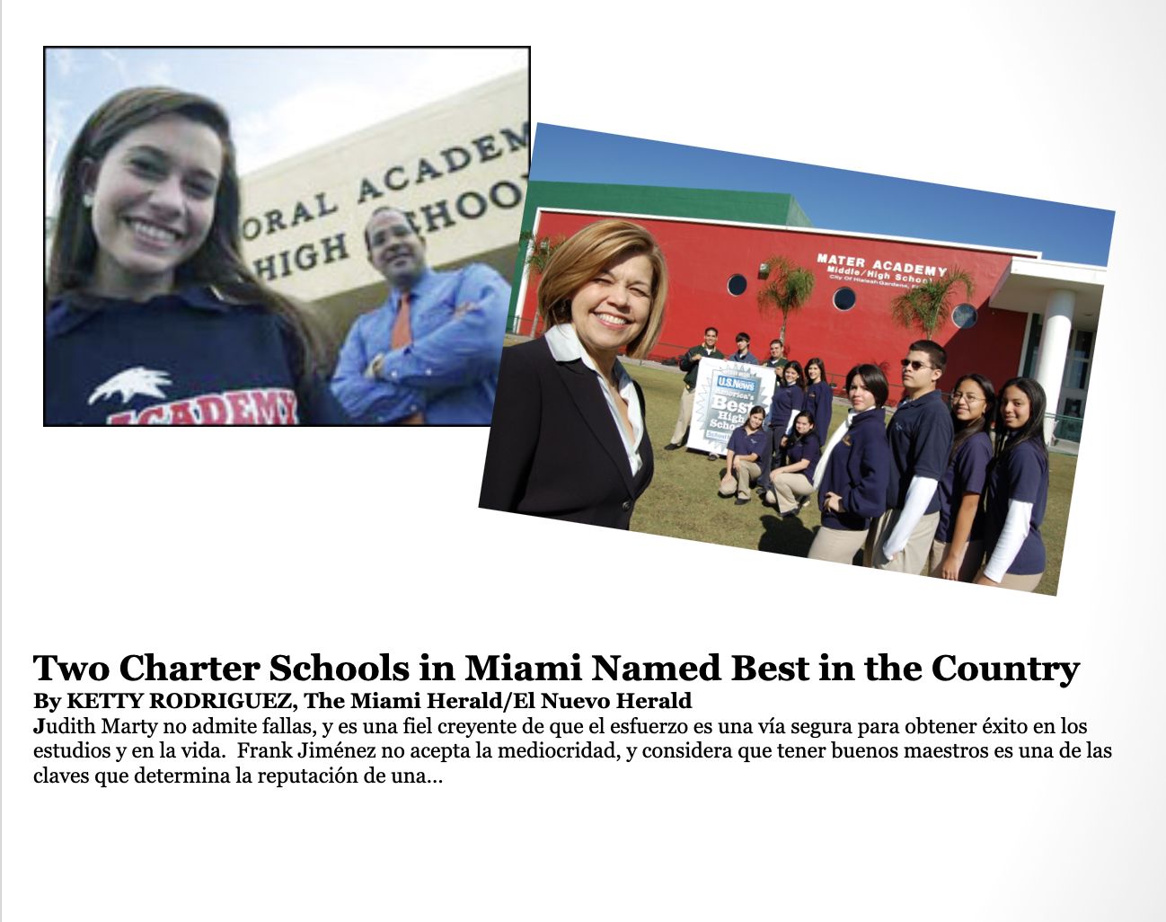
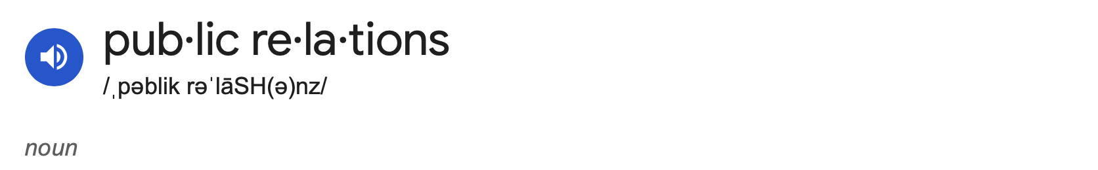
the practice of managing and disseminating information from an individual or an organization to the public in order to influence their perception.

Slide 13
FCSC+SCS 2024
Enrollmania Masterclass:
Strategies to Elevate Your Charter School Enrollment
Questions?
How have you successfully engaged prospective parents?
What marketing best practices have worked for your school?
What events have resulted in increased enrollment?
Who handles your school’s marketing efforts?
Do you need guidance writing a press release and contacting local media?
www.FLCharterAlliance
lynn@FLcharteralliance.org

Slide 14
Enrollmania Masterclass:
Strategies to Elevate Your Charter School Enrollment
FCSC+SCS 2024

